Slide 1
Chapter Eleven
Energy in Thermal Processes

Slide 2
Energy Transfer
When two objects of different temperatures are placed in thermal contact, the temperature of the warmer decreases and the temperature of the cooler increases
The energy exchange ceases when the objects reach thermal equilibrium
The concept of energy was broadened from just mechanical to include internal
  Made Conservation of Energy a universal law of nature
Introduction

Slide 3
Heat Compared to
Internal Energy
Important to distinguish between them
  They are not interchangeable
Heat involves a transfer of energy
Section 11.1

Slide 4
Internal Energy
Internal Energy, U, is the energy associated with the atoms and molecules of the system
  Includes kinetic and potential energy associated with the random translational, rotational and vibrational motion of the particles that make up the system
  Also includes any potential energy bonding the particles together
Section 11.1

Slide 5
Heat
Heat is the transfer of energy between a system and its environment because of a temperature difference between them
  The symbol Q is used to represent the amount of energy transferred by heat between a system and its environment
Section 11.1

Slide 6
Units of Heat
Calorie
  An historical unit, before the connection between thermodynamics and mechanics was recognized
  A calorie is the amount of energy necessary to raise the temperature of 1 g of water from 14.5° C to 15.5° C .
    A Calorie (food calorie) is 1000 cal
Section 11.1

Slide 7
Units of Heat, cont.
US Customary Unit – BTU
BTU stands for British Thermal Unit
  A BTU is the amount of energy necessary to raise the temperature of 1 lb of water from 63° F to 64° F
1 cal = 4.186 J
  This is called the Mechanical Equivalent of Heat
Section 11.1

Slide 8
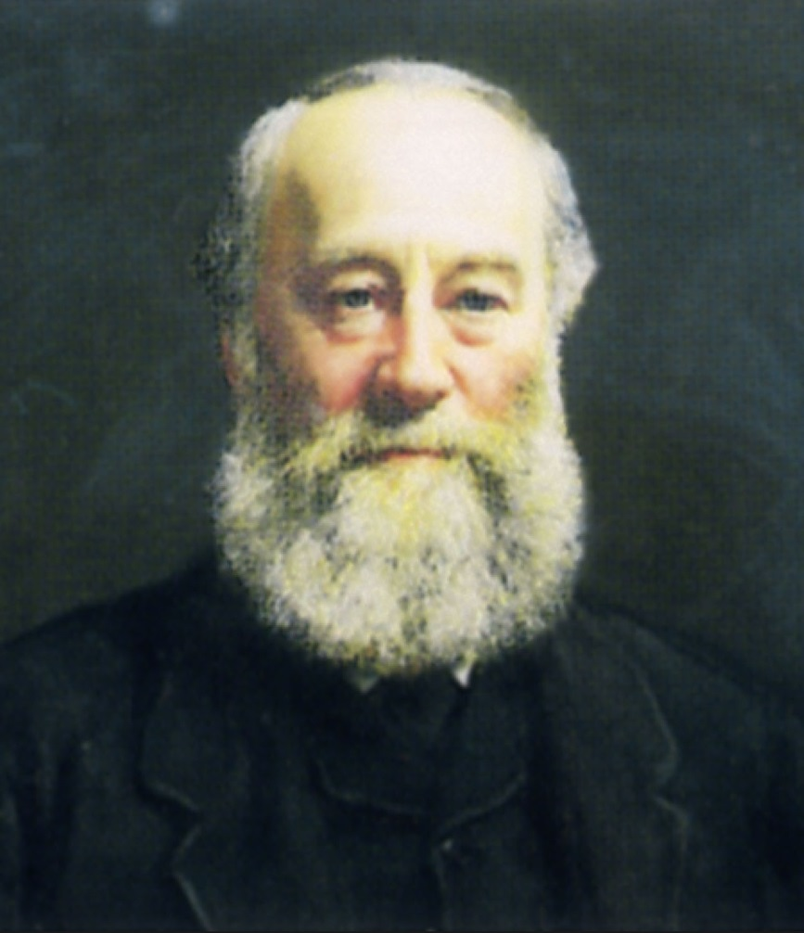
James Prescott Joule
1818 – 1889
British physicist
Conservation of Energy
Relationship between heat and other forms of energy transfer
Section 11.1

Slide 9
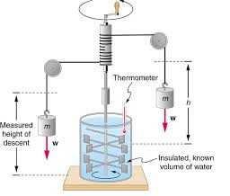
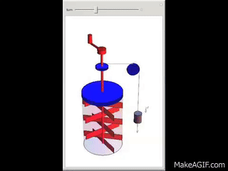

Slide 10
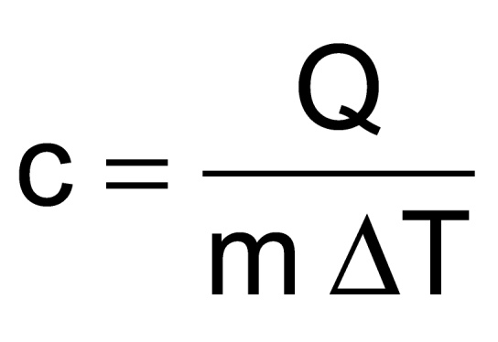
Specific Heat
Every substance requires a unique amount of energy per unit mass to change the temperature of that substance by 1° C
The specific heat, c, of a substance is a measure of this amount
Section 11.2

Slide 11
Units and Values of Specific Heat
SI units
  J / kg °C
Historical units
  cal / g °C
See table 11.1 for the specific heats of various materials
  These values are typical
    They may vary depending on the temperature and state of the material
Section 11.2

Slide 12
Heat and Specific Heat
Q = m c ΔT
ΔT is always the final temperature minus the initial temperature
When the temperature increases, ΔT and ΔQ are positive and energy flows into the system
When the temperature decreases, ΔT and ΔQ are negative and energy flows out of the system
Section 11.2

Slide 13
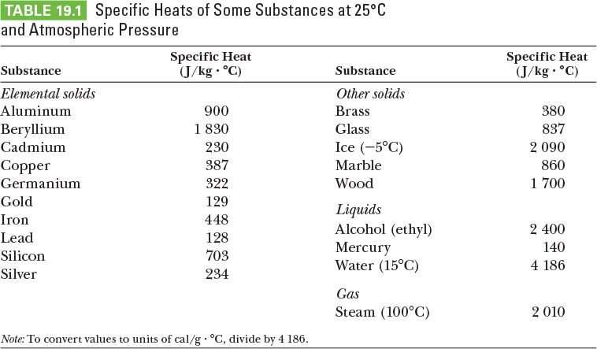
Specific Heats

Slide 14
Example
How much heat is required to raise the temperature of 50 g copper from 20 to 100 C.

Slide 15
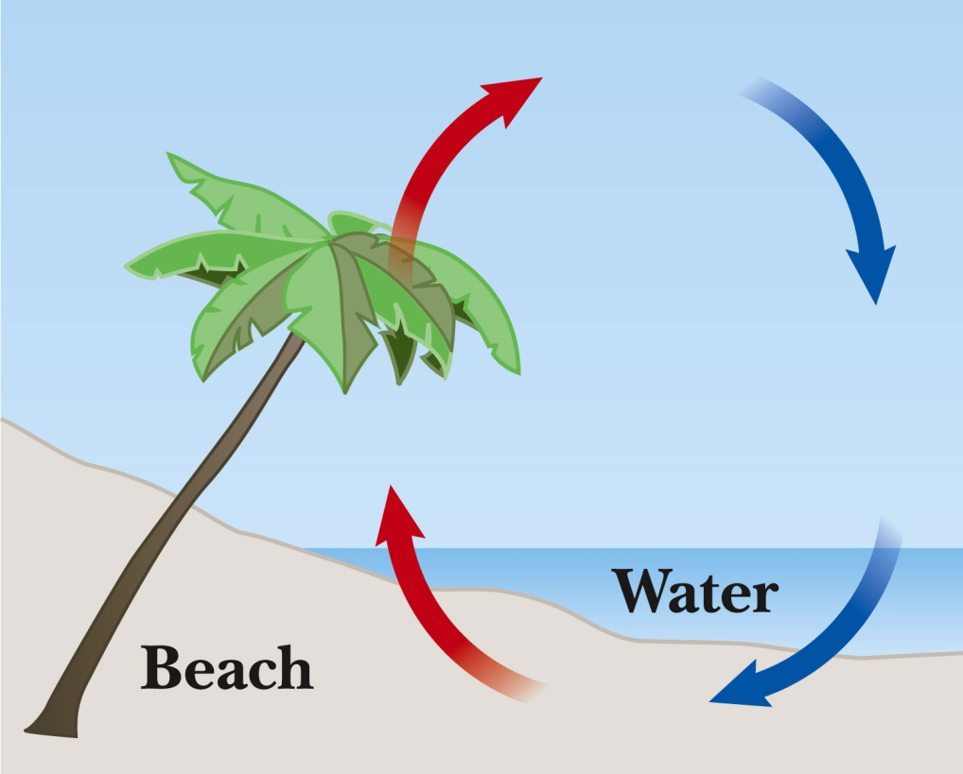
A Consequence of Different Specific Heats
Water has a high specific heat compared to land
On a hot day, the air above the land warms faster
The warmer air flows upward and cooler air moves toward the beach
Section 11.2

Slide 16
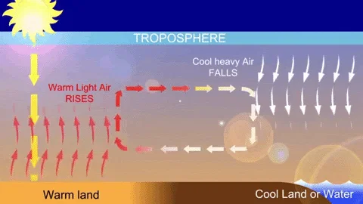

Slide 17
Calorimeter
Used in one technique for determining the specific heat of a substance
A calorimeter is a vessel that is a good insulator which allows a thermal equilibrium to be achieved between substances without any energy loss to the environment
Section 11.3

Slide 18
Calorimetry
Analysis performed using a calorimeter
Conservation of energy applies to the isolated system
The energy that leaves the warmer substance equals the energy that enters the water
  Q_{cold} = -Q_{hot}
  Negative sign keeps consistency in the sign convention of ΔT
Section 11.3

Slide 19
Calorimetry with More Than Two Materials
In some cases it may be difficult to determine which materials gain heat and which materials lose heat
You can start with ΣQ_{k} = 0
  Q_{k} is the energy of the k^{th} object
  Each Q = m c ΔT
  Use T_{f} – T_{i}
  You don’t have to determine before using the equation which materials will gain or lose heat
Section 11.3

Slide 20
Example
We take 200 g water at 20 C. Drop 100 g metal at 100 C into it. Final (equilibrium ) temperature is 24 C. Calculate the specific heat of the metal. Calorimeter is made of Aluminum, of mass 50 g.

Slide 21
Problem Solving Hint
It is important to organize the information in a problem
A table will be helpful
Headings can be
  Q_{material}
  m
  c
  T_{f}
  T_{i}
See example 11.4
Section 11.3

Slide 22
Phase Changes
A phase change occurs when the physical characteristics of the substance change from one form to another
Common phases changes are
  Solid to liquid – melting
  Liquid to gas – boiling
Phases changes involve a change in the internal energy, but no change in temperature
Section 11.4

Slide 23
Latent Heat
The energy Q needed to change the phase of a given pure substance is
  Q = ±m L
L is the called the latent heat of the substance
  Latent means hidden
  L depends on the substance and the nature of the phase change
Choose a positive sign if you are adding energy to the system and a negative sign if energy is being removed from the system
Section 11.4

Slide 24
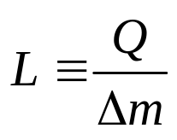
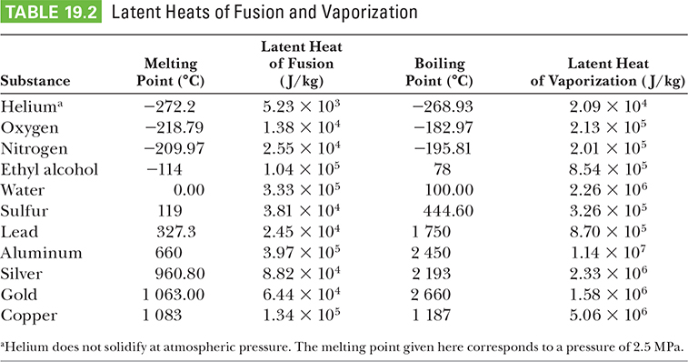
Latent Heat
Notes:
Latent heat of fusion L_{f} : phase change from solid to liquid (to fuse means “to combine by melting”)
Latent heat of vaporization L_{v}: phase change from liquid to gas (the liquid “vaporizes”)
Table: latent heats of various substances
When energy enters system, causing melting or vaporization, amount of higher-phase material increases:
Δm positive
Q positive
When energy extracted from a system, causing freezing or condensation, amount of higher-phase material decreases:
Δm negative
Q negative
Note: Δm in equation always refers to higher-phase material

Slide 25
Latent Heat, cont.
SI unit of latent heat are J / kg
Latent heat of fusion, L_{f}, is used for melting or freezing
Latent heat of vaporization, L_{v}, is used for boiling or condensing
Table 11.2 gives the latent heats for various substances
Section 11.4

Slide 26
Example

Slide 27
Sublimation
Some substances will go directly from solid to gaseous phase
  Without passing through the liquid phase
This process is called sublimation
  There will be a latent heat of sublimation associated with this phase change
Section 11.4

Slide 28
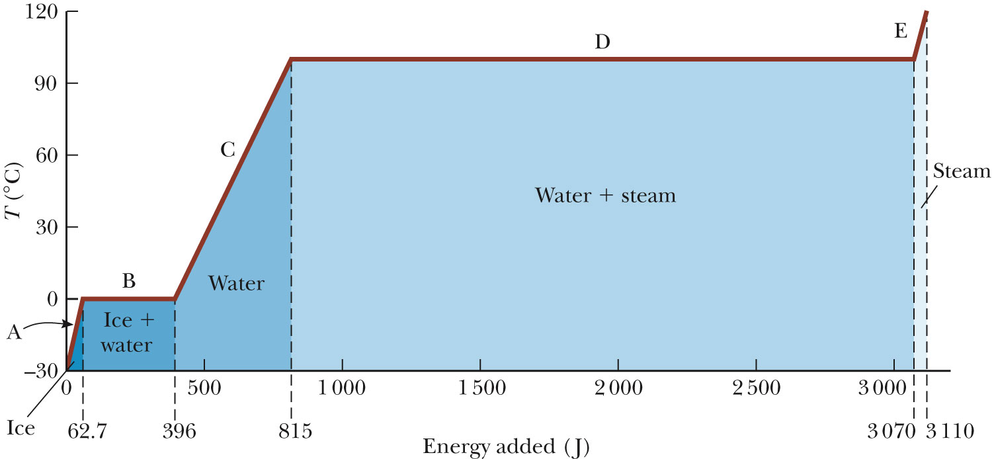
Graph of Ice to Steam
Section 11.4

Slide 29
ss
Cold ice
Ice at 0 C
Water at 0C
Water at 100 C
Steam at 100 C
Hot steam

Slide 30
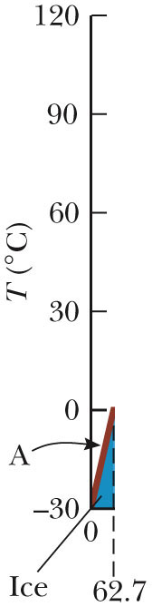
Warming Ice
Start with one gram of ice at –30.0° C
During A, the temperature of the ice changes from –30.0° C to 0º C
Use Q = m c ΔT
Will add 62.7 J of energy
Section 11.4

Slide 31
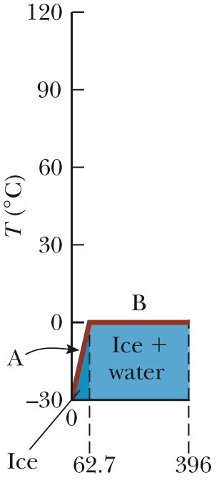
Melting Ice
Once at 0° C, the phase change (melting) starts
The temperature stays the same although energy is still being added
Use Q = m L_{f}
Needs 333 J of energy
Section 11.4

Slide 32
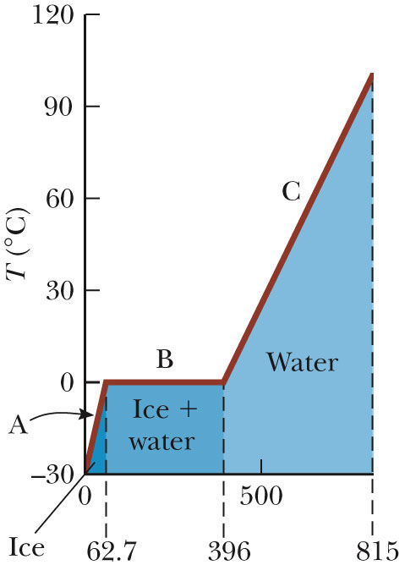
Warming Water
Between 0° C and 100° C, the material is liquid and no phase changes take place
Energy added increases the temperature
Use Q = m c ΔT
419 J of energy are added
Section 11.4

Slide 33
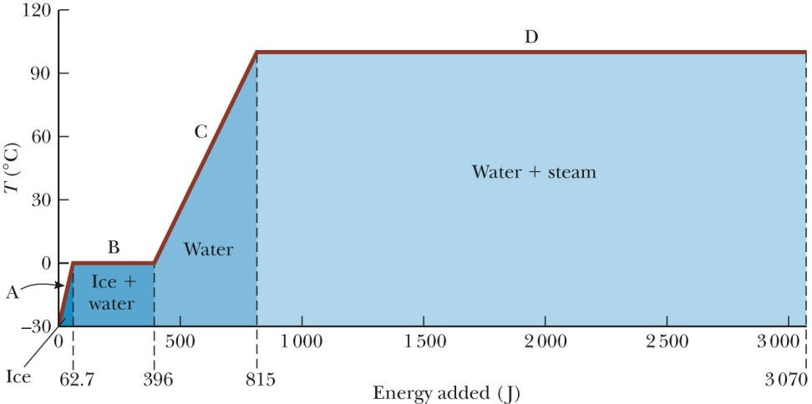
Boiling Water
At 100° C, a phase change occurs (boiling)
Temperature does not change
Use Q = m L_{v}
2 260 J of energy are needed
Section 11.4

Slide 34
Heating Steam
After all the water is converted to steam, the steam will heat up
No phase change occurs
The added energy goes to increasing the temperature
Use Q = m c ΔT
To raise the temperature of the steam to 120°, 40.2 J of energy are needed
Section 11.4

Slide 35
Problem Solving Strategies
Make a table
  A column for each quantity
  A row for each phase and/or phase change
  Use a final column for the combination of quantities
  Use consistent units
Section 11.4

Slide 36
Problem Solving Strategies, cont
Apply Conservation of Energy
  Transfers in energy are given as Q=mcΔT for processes with no phase changes
  Use Q = m L_{f} or Q = m L_{v} if there is a phase change
  Start with ΣQ = 0
    Or Q_{cold} = - Q_{hot}, but be careful of signs
  ΔT is T_{f} – T_{i}
Solve for the unknown
Section 11.4

Slide 37
Methods of Heat Transfer
Need to know the rate at which energy is transferred
Need to know the mechanisms responsible for the transfer
Methods include
  Conduction
  Convection
  Radiation
Section 11.5

Slide 38
Conduction
The transfer can be viewed on an atomic scale
  It is an exchange of energy between microscopic particles by collisions
  Less energetic particles gain energy during collisions with more energetic particles
Rate of conduction depends upon the characteristics of the substance
Section 11.5

Slide 39
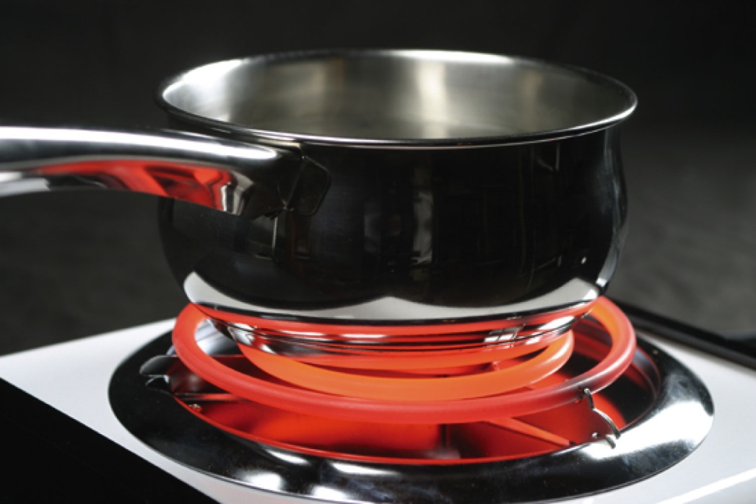
Conduction example
The molecules vibrate about their equilibrium positions
Particles near the stove coil vibrate with larger amplitudes
These collide with adjacent molecules and transfer some energy
Eventually, the energy travels entirely through the pan and its handle
Section 11.5

Slide 40

Conduction, cont.
Section 11.5

Slide 41
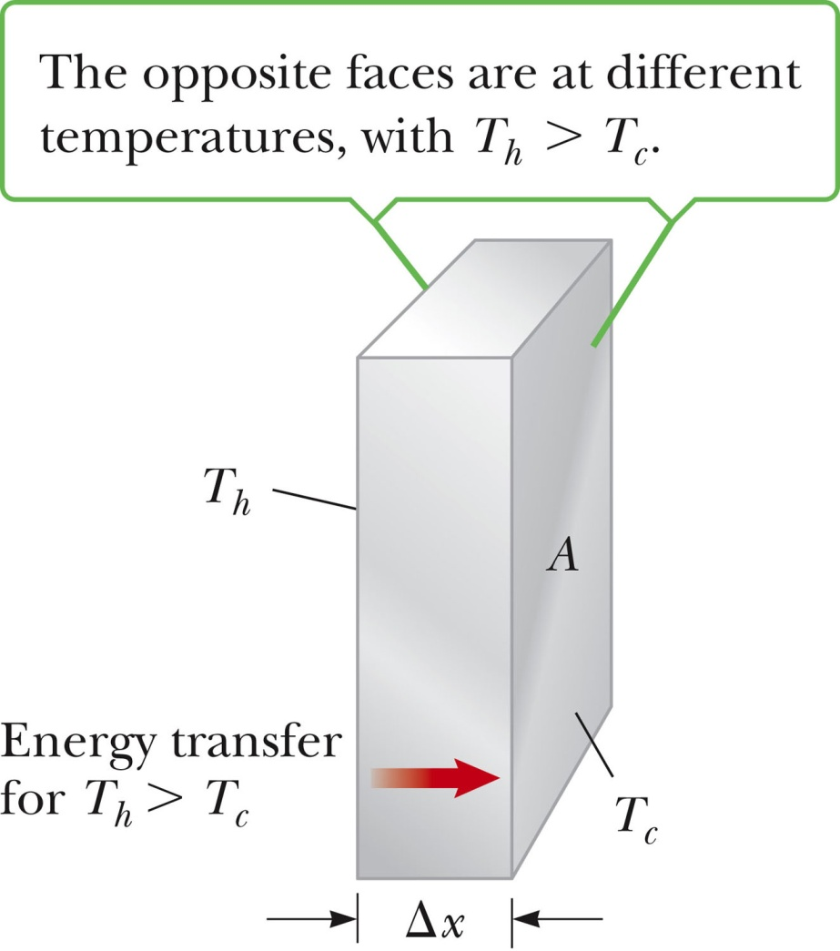
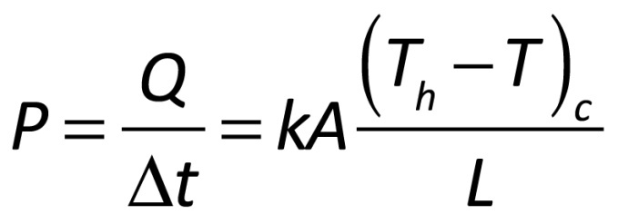
Conduction, equation
The slab of material allows energy to transfer from the region of higher temperature to the region of lower temperature
A is the cross-sectional area
Section 11.5

Slide 42
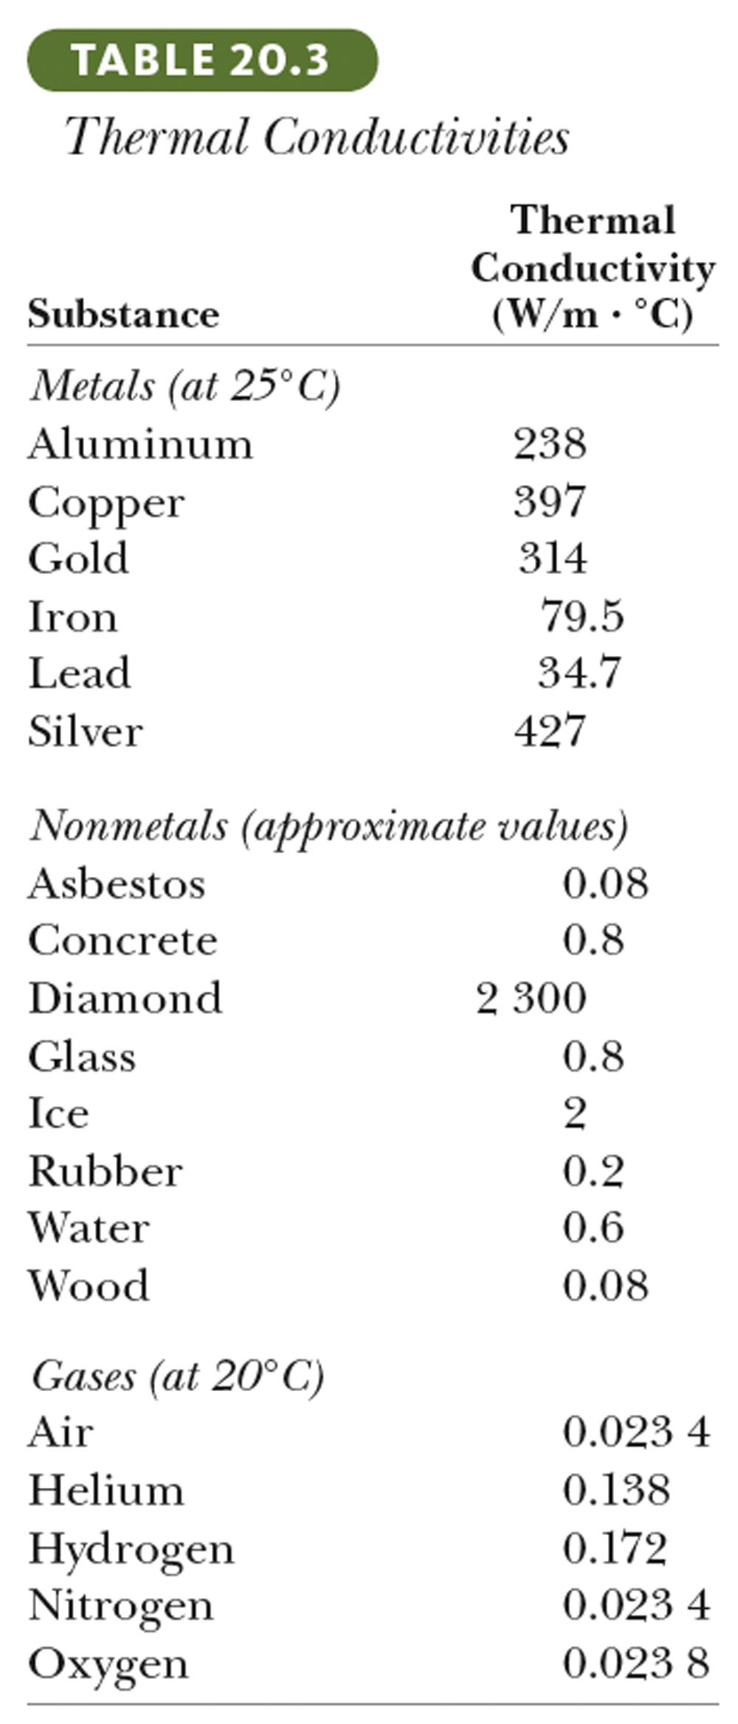
Conduction
A is the cross-sectional area
Δx = L = thickness or length
P is in Watts when Q is in Joules and t is in seconds
k is the thermal conductivity of the material
  Table has some values of conductivities
  Good conductors have high k values and good insulators have low k values
Section 11.5

Slide 43
Example
Calculate the heat lost in 5 minutes through a glass window. Thickness = 0.8 cm, area of window = 2 m², Temp inside = 23C, outside = 5C. k = 0.8 W/mC.

Slide 44
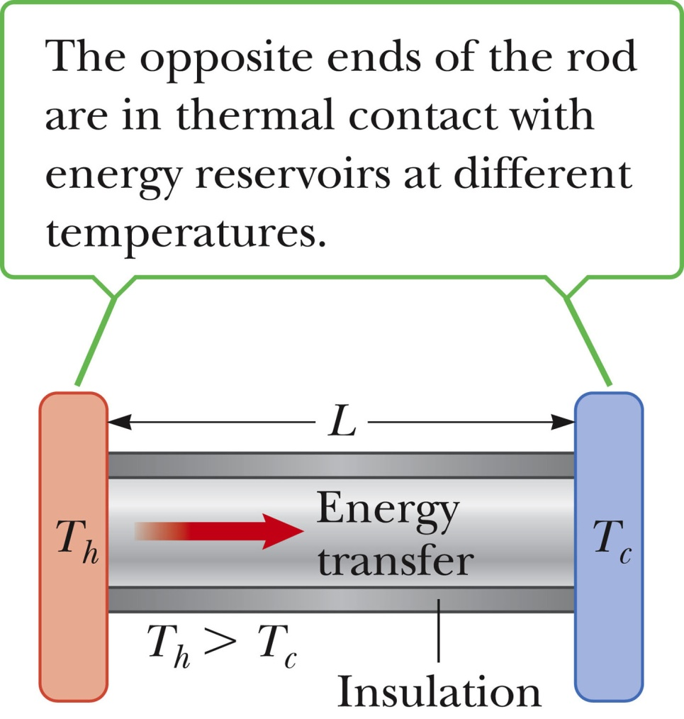
Conduction, equation explanation
A is the cross-sectional area
Through a rod, Δx = L
P is in Watts when Q is in Joules and t is in seconds
k is the thermal conductivity of the material
  See table 11.3 for some conductivities
  Good conductors have high k values and good insulators have low k values
Section 11.5

Slide 45
Home Insulation
Substances are rated by their R values
  R = L / k
  See table 11.4 for some R values
For multiple layers, the total R value is the sum of the R values of each layer
Wind increases the energy loss by conduction in a home
Section 11.5

Slide 46
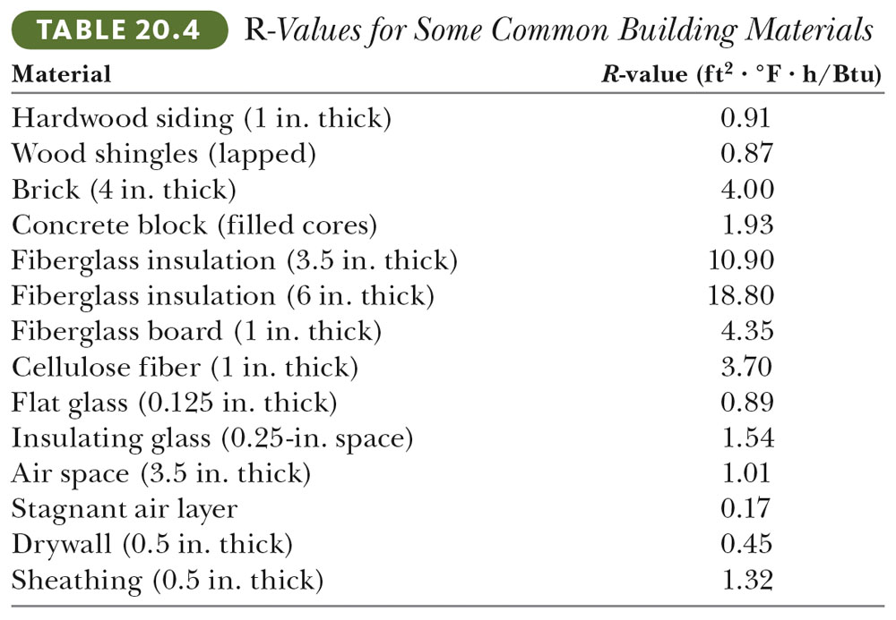
R-values

Slide 47
Conduction and Insulation with Multiple Materials
Each portion will have a specific thickness and a specific thermal conductivity
The rate of conduction through each portion is equal
Section 11.5

Slide 48
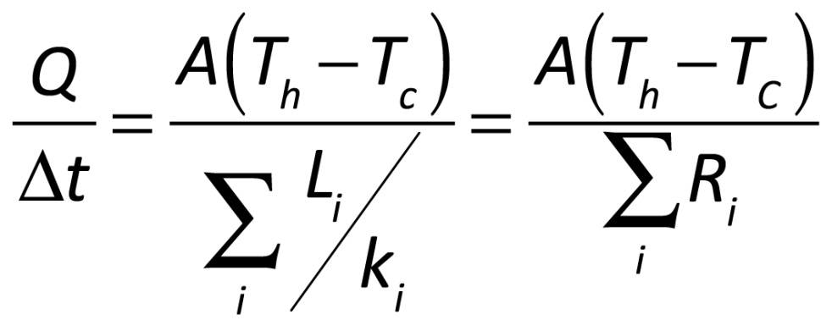
Multiple Materials, cont.
The rate through the multiple materials will be
T_{H} and T_{C} are the temperatures at the outer extremities of the compound material
Section 11.5

Slide 49
Example – multilayered wall

Slide 50
Convection
Energy transferred by the movement of a substance
  When the movement results from differences in density, it is called natural convection
  When the movement is forced by a fan or a pump, it is called forced convection
Section 11.5

Slide 51
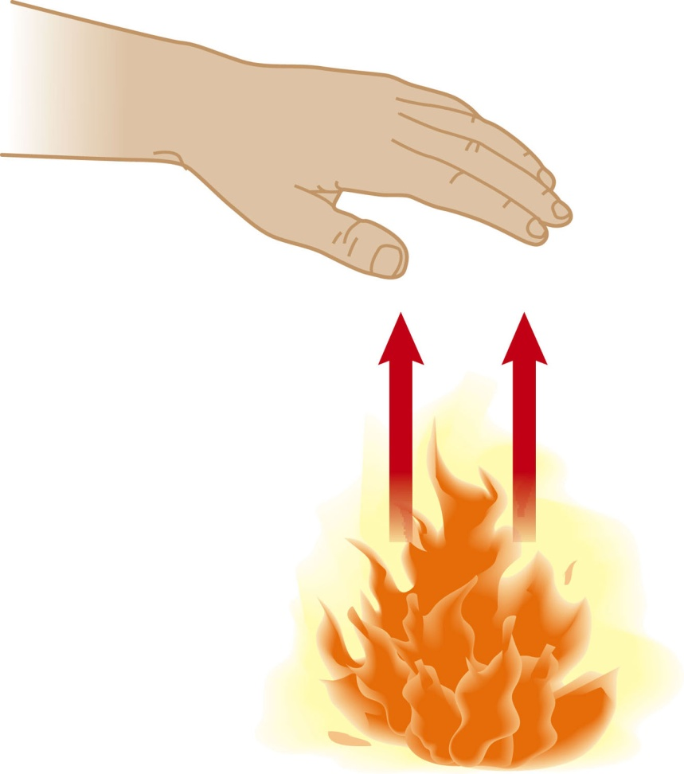
Convection example
Air directly above the flame is warmed and expands
The density of the air decreases, and it rises
The mass of air warms the hand as it moves by
Section 11.5

Slide 52
Convection applications
Boiling water
Radiators
Upwelling
Cooling automobile engines
Algal blooms in ponds and lakes
Section 11.5

Slide 53
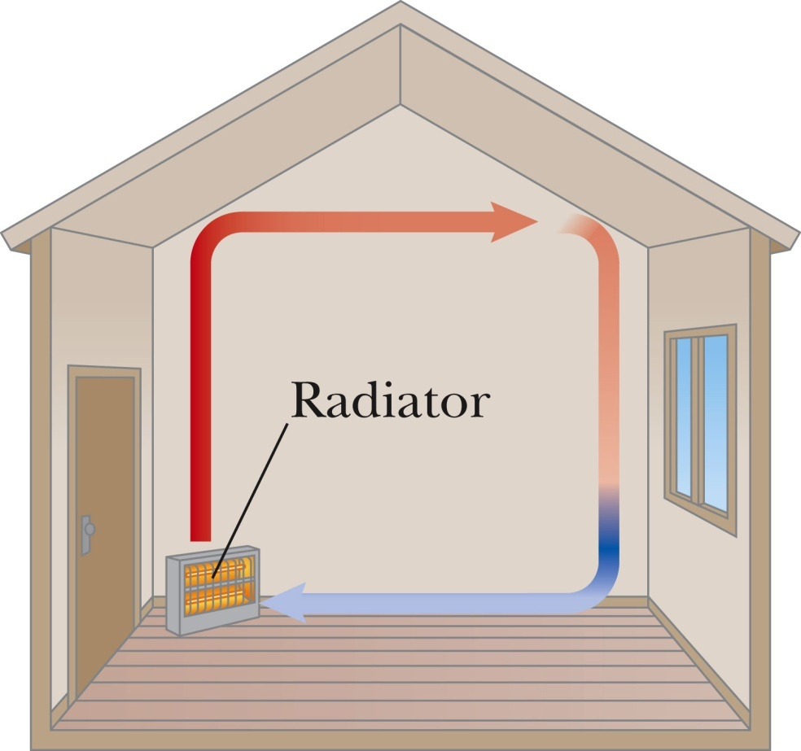
Convection Current Example
The radiator warms the air in the lower region of the room
The warm air is less dense, so it rises to the ceiling
The denser, cooler air sinks
A continuous air current pattern is set up as shown
Section 11.5

Slide 54
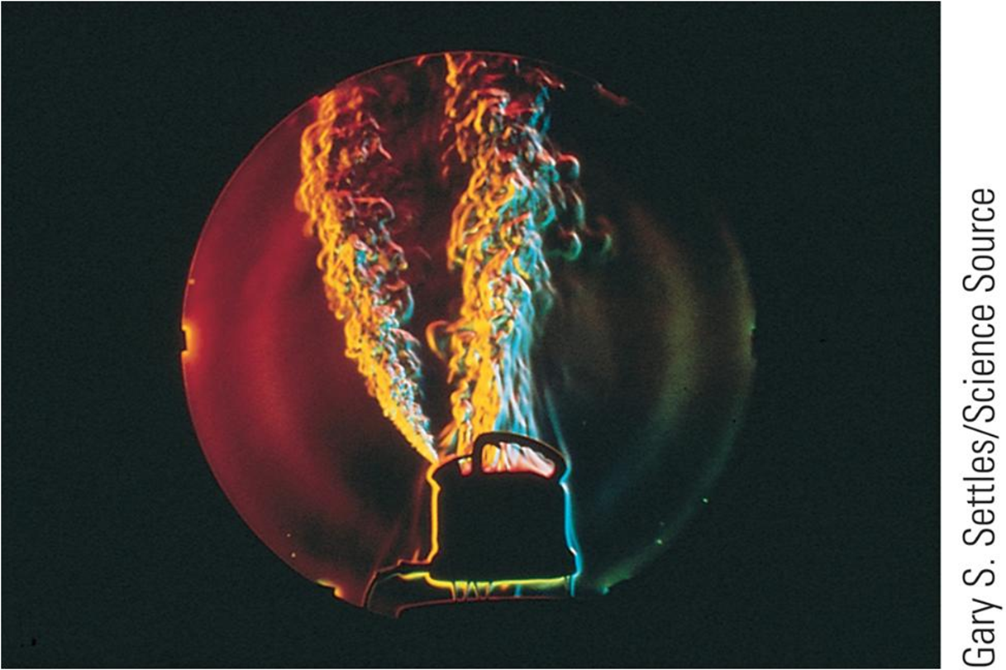
Convection (2 of 4)
Notes:
Figure 11.11 Photograph of a teakettle, showing steam and turbulent convection air currents.
When the substance is forced to move by a fan or pump, as in some hot air and hot water heating systems, the process is called forced convection. Look at the photo. Convection currents help water to boil. In a teakettle on a hot stovetop, the lower layers of water are warmed first. The warmed water has a lower density and rises to the top, while the denser, cool water at the surface sinks to the bottom of the kettle and is warmed.

Slide 55
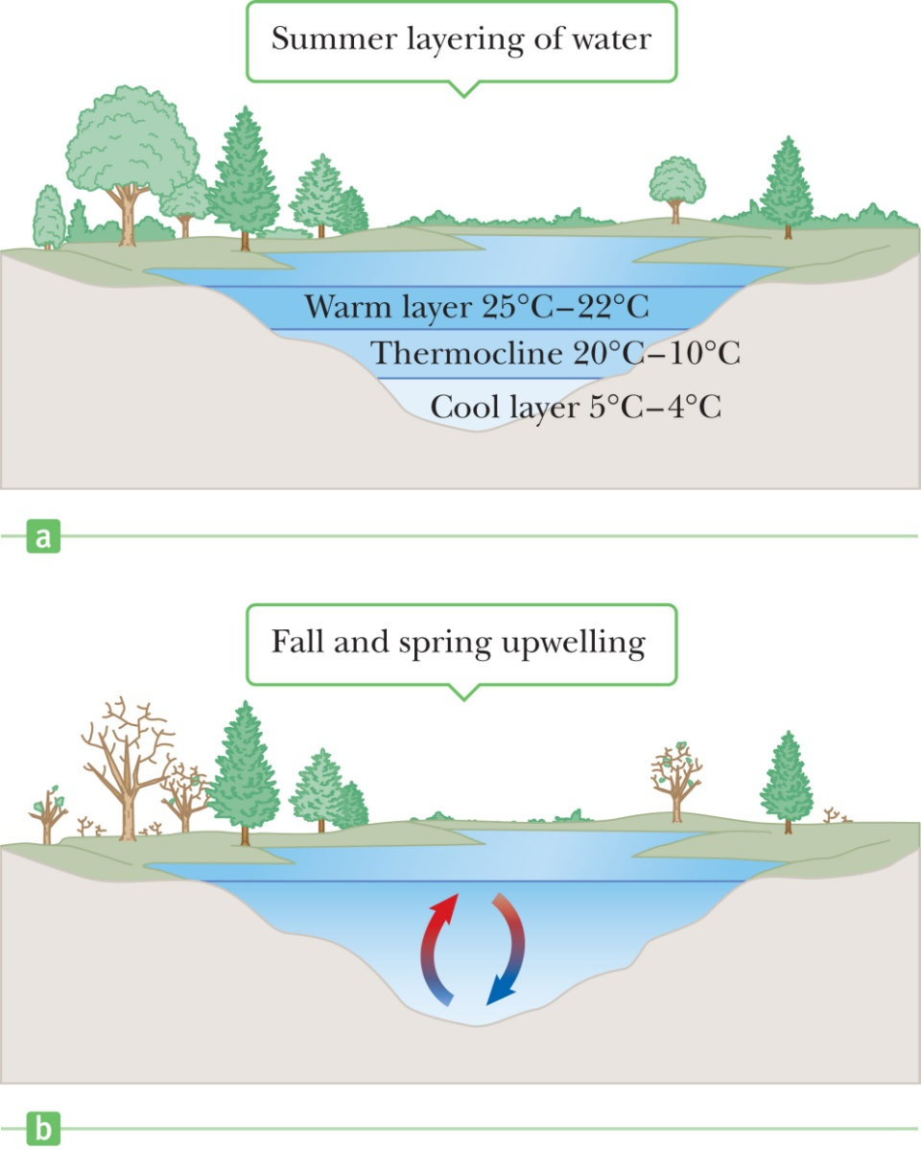
Convection (4 of 4)
Notes:
Figure 11.13 (a) During the summer, a warm upper layer of water is separated from a cooler lower layer by a thermocline. (b) Convection currents during the spring and fall mix the water and can cause algal blooms.
You may have seen algal blooms in a lake or ponds during the spring or fall. These are caused by convection currents in the water. Take a look at the figure. During the summer, bodies of water develop temperature gradients, with a warm upper layer of water separated from a cold lower layer by a buffer zone called a thermocline. In the spring and fall temperature changes in the water break down this thermocline, setting up convection currents that mix the water. The mixing process transports nutrients from the bottom to the surface. The nutrient-rich water forming at the surface can cause a rapid, temporary increase in the algae population.

Slide 56
Radiation
Radiation does not require physical contact
All objects radiate energy continuously in the form of electromagnetic waves due to thermal vibrations of the molecules
Rate of radiation is given by Stefan’s Law
Section 11.5

Slide 57
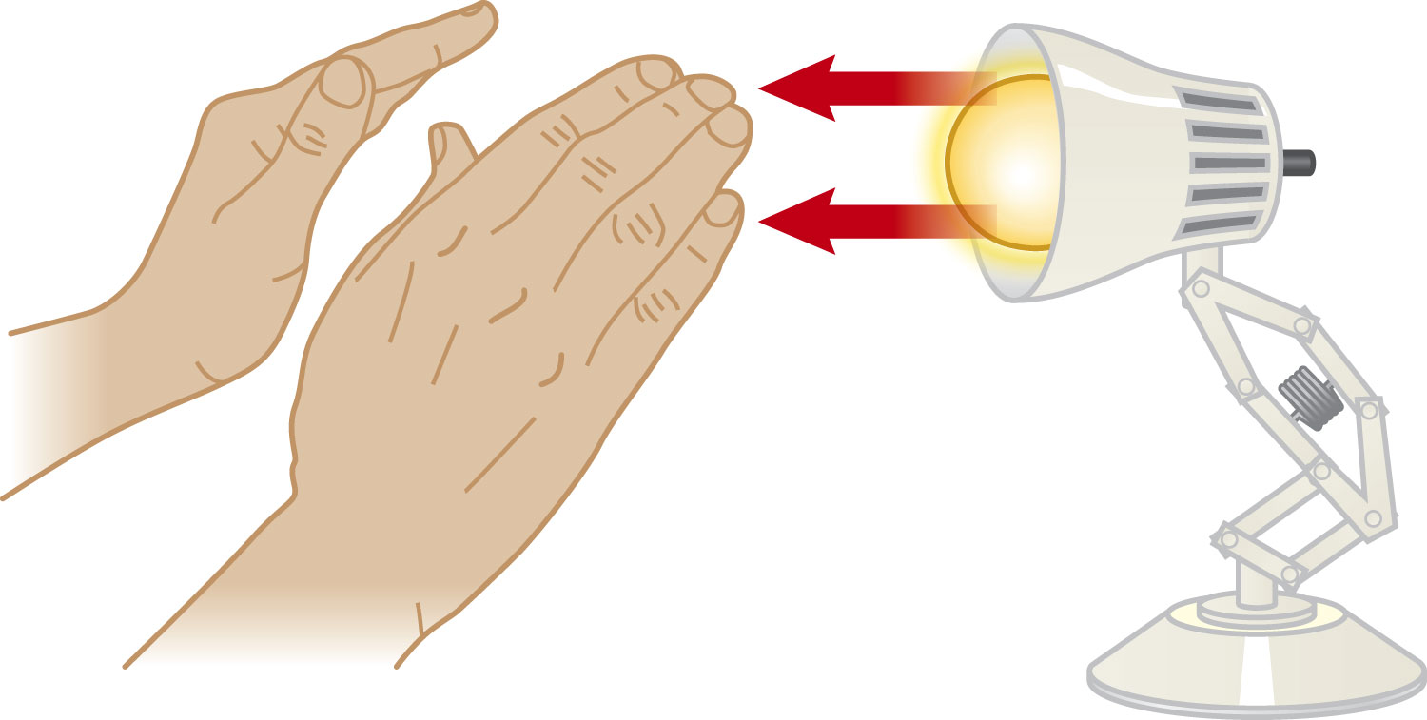
Radiation example
The electromagnetic waves carry the energy from the fire to the hands
No physical contact is necessary
Cannot be accounted for by conduction or convection
Section 11.5

Slide 58
Radiation equation
P = σ A e T⁴
  The power is the rate of energy transfer, in Watts
  σ = 5.669 6 x 10⁻⁸ W/m^{2.}K⁴
    Called the Stefan-Boltzmann constant
  A is the surface area of the object
  e is a constant called the emissivity
    e varies from 0 to 1
  T is the temperature in Kelvins
Section 11.5

Slide 59
Energy Absorption and Emission by Radiation
The rate at which the object at temperature T with surroundings at T_{o} radiates is
  P_{net} = σ A e (T⁴ - T_{o}⁴)
  P is energy radiated per second ( J/s = W)
  When an object is in equilibrium with its surroundings, it radiates and absorbs at the same rate
    Its temperature will not change
Section 11.5

Slide 60
Example
Calculate the energy radiated by the Earth. Temp = 300 K, e = 0.9

Slide 61
Ideal Absorbers
An ideal absorber is defined as an object that absorbs all of the energy incident on it
  e = 1
This type of object is called a black body
An ideal absorber is also an ideal radiator of energy, so e = 1
Section 11.5

Slide 62
Ideal Reflector
An ideal reflector absorbs none of the energy incident on it
  e = 0
Section 11.5

Slide 63
Applications of Radiation
Clothing
  Black fabric acts as a good absorber
  White fabric is a better reflector
Thermography
  The image of the pattern formed by varying radiation levels is called a thermogram
Body temperature
  Radiation thermometer measures the intensity of the infrared radiation from the eardrum
Section 11.5

Slide 64
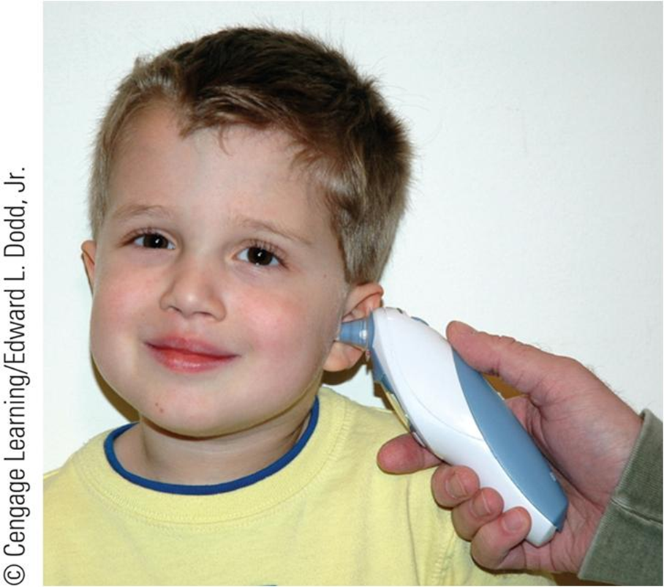
Radiation (6 of 6)
Notes:
Figure 11.17 A radiation thermometer measures a patient’s temperature by monitoring the intensity of infrared radiation leaving the ear.
This figure shows a radiation thermometer, which measures the intensity of the infrared radiation leaving the eardrum and surrounding tissues and converts this information to a standard numerical reading. The eardrum is a particularly good location to measure body temperature because it’s near the hypothalamus, the body’s temperature control center.

Slide 65
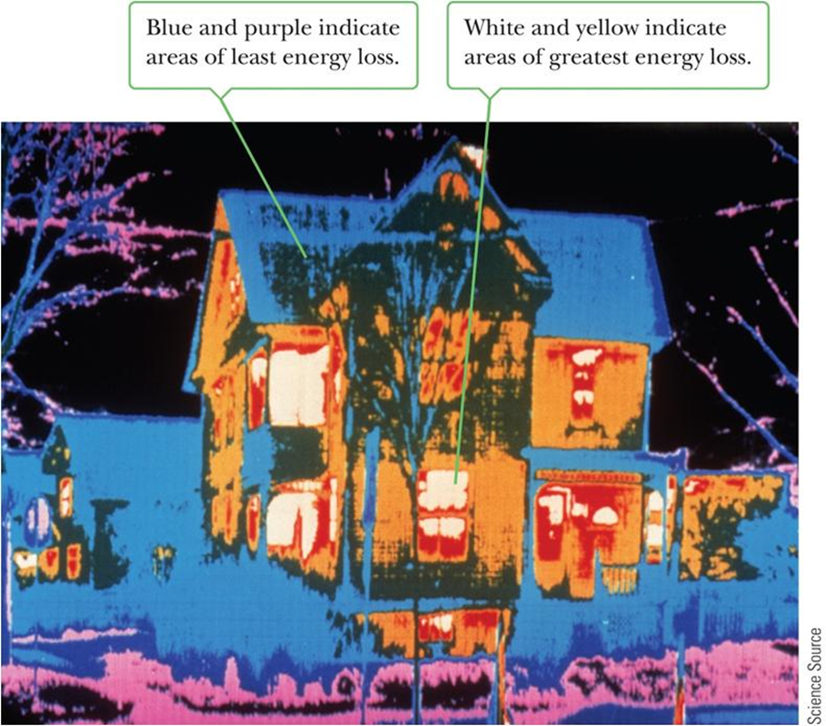
Radiation (4 of 6)
Notes:
Figure 11.15 Thermogram of a house, made during cold weather.
The amount of energy radiated by an object can be measured with a thermogram, which is an image of the pattern formed by varying radiation levels. In a thermogram, the brightest areas are the warmest, as you can see in the photo of a house. It is clear that more energy escapes in the lighter regions, which is through the door and windows. The owners of this house could conserve energy and reduce their heating costs by adding insulation to the attic area and by installing thermal draperies over the windows.

Slide 66
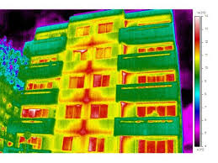
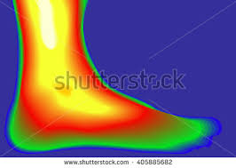

Slide 67
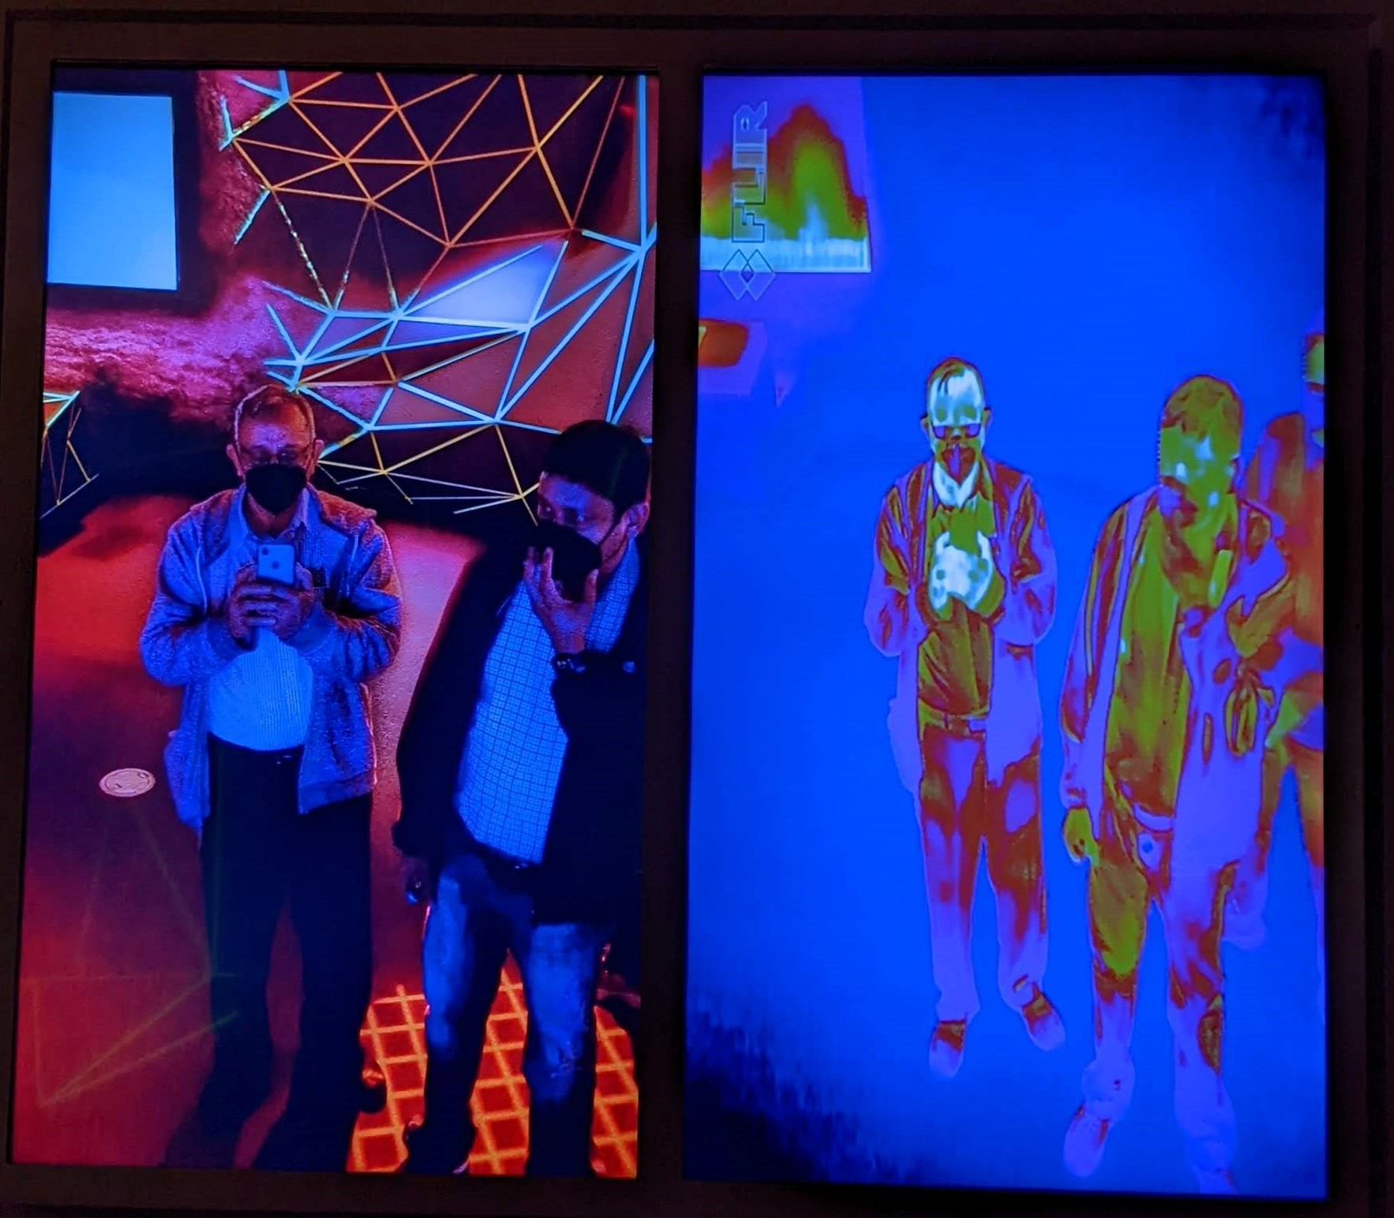
Infrared Camera in the Houston Science Museum

Slide 68
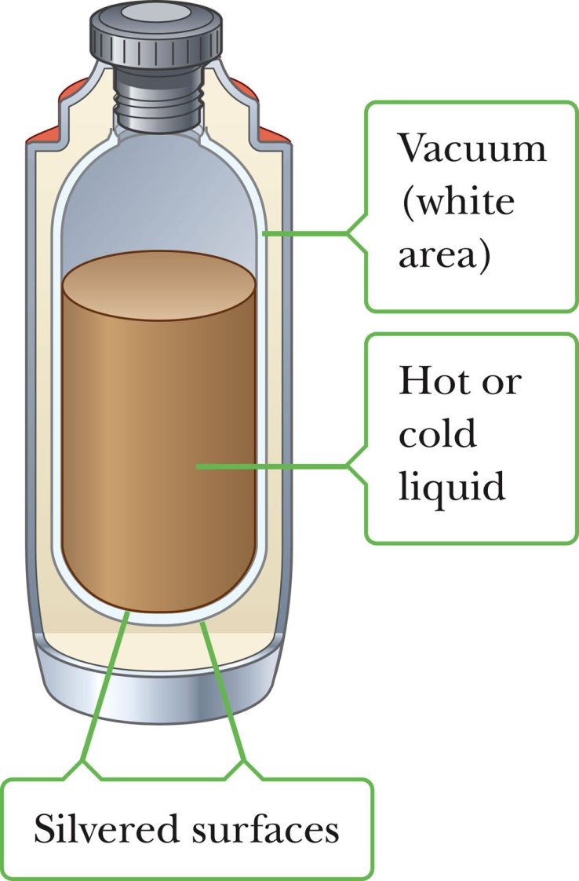
Resisting Energy Transfer
Dewar flask/thermos bottle
Designed to minimize energy transfer to surroundings
Space between walls is evacuated to minimize conduction and convection
Silvered surface minimizes radiation
Neck size is reduced
Section 11.5

Slide 69
Global Warming
Greenhouse example
  Visible light is absorbed and re-emitted as infrared radiation
  Convection currents are inhibited by the glass
Earth’s atmosphere is also a good transmitter of visible light and a good absorber of infrared radiation
Section 11.6

Slide 70
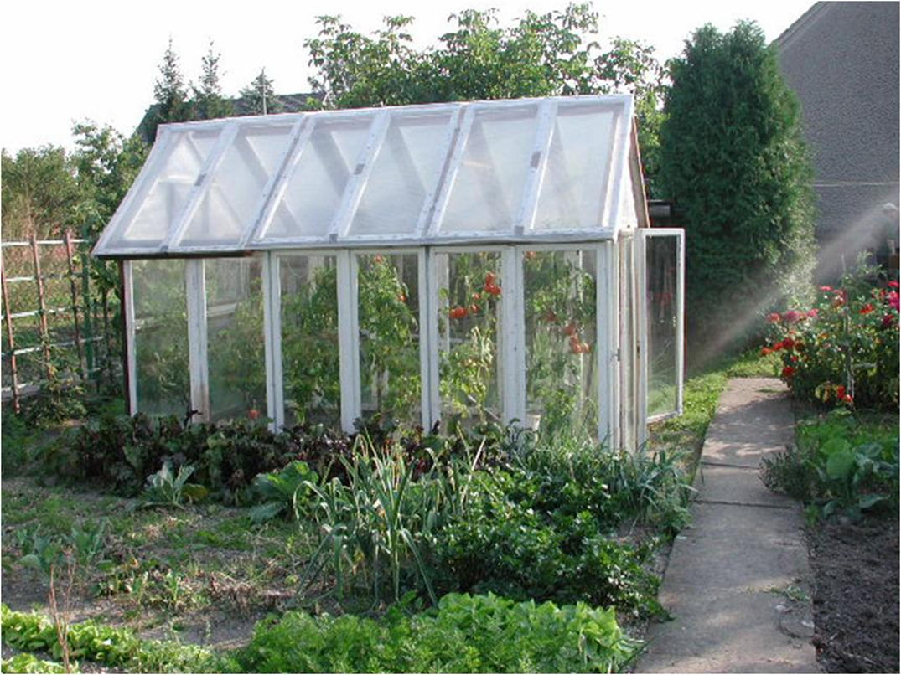
Climate Change and Greenhouse Gases (1 of 3)
Notes:
Figure Garden greenhouse.
Let’s talk about how a glass greenhouse works. During the day, sunlight passes into the greenhouse and is absorbed by the walls, soil, and plants. This absorbed visible light is reradiated as infrared radiation, causing the temperature of the interior to rise. Convection currents are inhibited in a greenhouse. As a result, warmed air can’t rapidly pass over the surfaces of the greenhouse that are exposed to the outside air and so there is little energy loss by conduction through those surfaces.
Most experts now consider this restriction to be a more important warming effect than the trapping of infrared radiation. In fact, experiments have shown that when the glass over a greenhouse is replaced by a special glass known to transmit infrared light, the temperature inside is lowered only slightly. On the basis of this evidence, the primary mechanism that raises the temperature of a greenhouse is not the trapping of infrared radiation, but the inhibition of airflow that occurs under any roof (in an attic, for example).
A phenomenon commonly known as the greenhouse effect can also play a major role in determining the Earth’s temperature. First, note that the Earth’s atmosphere is a good transmitter (which means a poor absorber) of visible radiation and a good absorber of infrared radiation. The visible light that reaches the Earth’s surface is absorbed and reradiated as infrared light, which in turn is absorbed, or trapped, by the Earth’s atmosphere.
Image Credit:
https://commons.wikimedia.org/wiki/File%3AGartengew%C3%A4chshaus.JPG
By Jürgi-würgi (Own work) [Public domain], via Wikimedia Commons

Slide 71
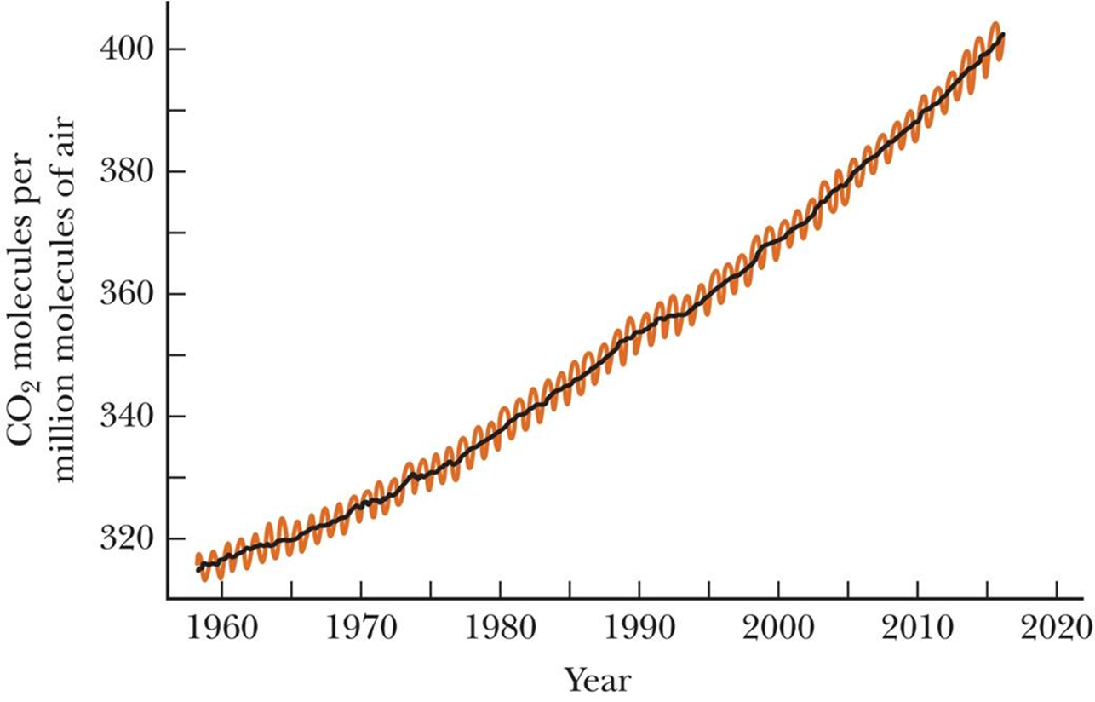
Climate Change and Greenhouse Gases (2 of 3)
Notes:
Figure 11.20 The concentration of atmospheric carbon dioxide in parts per million (ppm) of dry air as a function of time during the latter part of the 20th century. These data were recorded at Mauna Loa Observatory in Hawaii. The yearly variations (rust-colored curve) coincide with growing seasons because vegetation absorbs carbon dioxide from the air. The steady increase (black curve) is of concern to scientists.
As fossil fuels. such as coal, oil, and natural gas are burned, large amounts of carbon dioxide are released into the atmosphere, causing it to retain more energy. These emissions are of great concern to scientists and governments throughout the world. Many scientists are convinced that the 10% increase in the amount of atmospheric carbon dioxide since 1970 could lead to drastic changes in world climate.
The increase in concentration of atmospheric carbon dioxide in the latter part of the 20th century and the first years of the 21st century is shown in the figure.
According to one estimate, doubling the carbon dioxide content in the atmosphere will cause temperatures to increase by 2°C. In temperate regions such as Europe and the United States, a 2°C temperature rise would save billions of dollars per year in fuel costs. Unfortunately, it would also melt a large amount of land-based ice from Greenland and Antarctica, raising the level of the oceans and destroying many coastal regions. A 2°C rise would also increase the frequency of droughts and consequently decrease already low crop yields in tropical and subtropical countries. Even slightly higher average temperatures might make it impossible for certain plants and animals to survive in their customary ranges.
At this time, about 3.5 × 10¹⁰ tons of carbon dioxide are released into the atmosphere each year. Most of this gas results from human activities such as the burning of fossil fuels, the cutting of forests, and manufacturing processes.
Another greenhouse gas is methane, which is released in the digestive process of cows and other ruminants. This gas originates from that part of the animal’s stomach called the rumen, where cellulose is digested. Termites are also major producers of this gas. Greenhouse gases such as nitrous oxide and sulfur dioxide are increasing due to automobile and industrial pollution.
The Montreal Protocol on Substances that Deplete the Ozone Layer is considered to be the most successful international environmental agreement, which resulted in a 97% reduction in ozone-depleting substances. Many of these substances were replaced with hydrofluorocarbons and it is now understood that HFCs can be up to 10,000 times more potent than carbon dioxide in contributing to climate change. The international community is working together on a 2016 Amendment to the Montreal Protocol to reduce the production and consumption of HFCs.

Slide 72
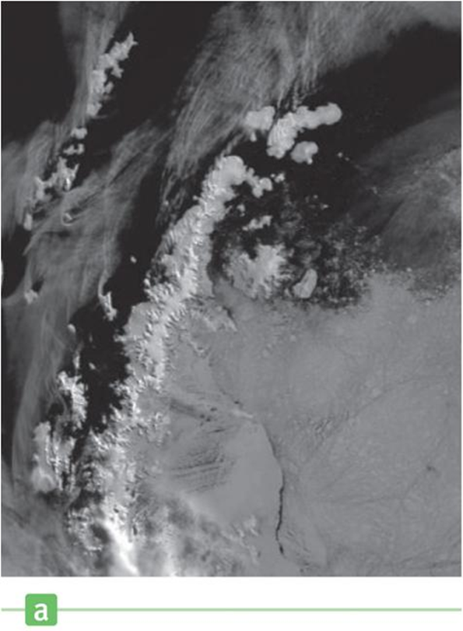
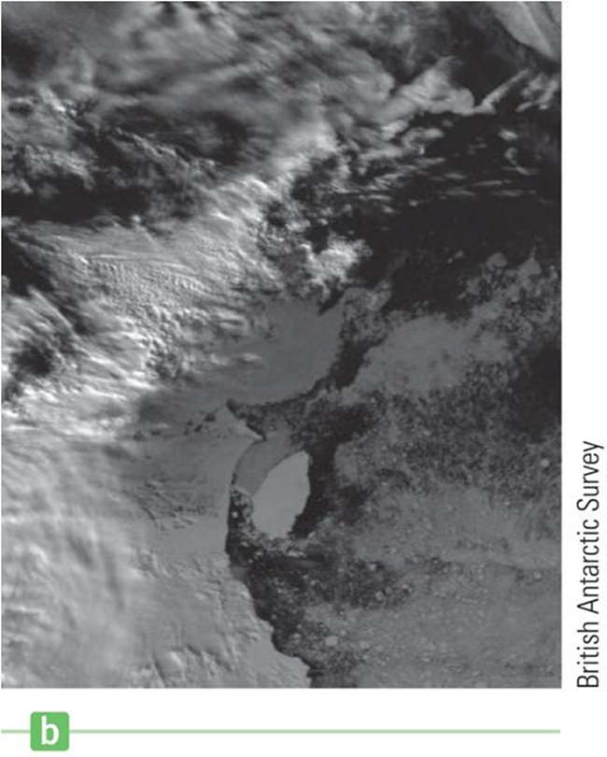
Climate Change and Greenhouse Gases (3 of 3)
Notes:
Figure 11.21 Death of an ice shelf. The image in (a), taken on January 9, 1995, in the near-visible part of the spectrum, shows James Ross Island (spidery-shaped, just off center) before the iceberg calved, but after the disintegration of the ice shelf between James Ross Island and the Antarctic peninsula. In the image in part (b), taken on February 12, 1995, the iceberg has calved and begun moving away from land. The iceberg is about 78 km by 27 km and 200 m thick. A century ago James Ross Island was completely surrounded in ice that joined it to Antarctica.
There is convincing evidence that climate change is under way. Evidence comes from the melting of ice in Antarctica and the retreat of glaciers at widely scattered sites throughout the world, as you can see in the figure.
For example, satellite images of Antarctica show James Ross Island completely surrounded by water for the first time since maps were made, about 100 years ago. Previously, the island was connected to the mainland by an ice bridge.
At different places across the continent, ice shelves are retreating, some at a rapid rate. The Swiss Alps have lost about 50% of their glacial ice compared to 130 years ago.
In about 50 years, the amount of carbon dioxide in the atmosphere is expected to be about twice what it was in the preindustrial era. Because of the possible catastrophic consequences, most scientists agree we need to reduce greenhouse gas emissions right now.

